Slide 1
RARA ELECTRONICS LLC
2023 EDITION

Slide 2
COMPANY INTRODUCTION
RARA’s Main Resitive Items:
1/ High power, metal clad, wire wound 2/ Power film 3/ SMD 4/ Current sensing 5/ Precision 6/ High voltage 7/ Ceramic 8/ NGR, Loadbank, Motor control 9/ Inductors 10/ Heaters 11/ Variable
RARA ELECTRONICS
“Your one-stop resistive solutions specialists".
Since 1989 RARA has been providing Korea and the world with high quality, competitive and innovative products.
Every product tested and guaranteed.
More info on products can be found at: www.raraohm.com
Like us on Facebook at: www.facebook.com/powerresistors/ Follow us on twitter at: http://www.twitter.com/CorporationRara/

Slide 3
BUSINESS PROFILE
Financial and Administrative Summary: RARA started with an initial capital of five hundred million won. As of December 31st, 2019, the capital had increased to US$9.8 million. The company currently employs sixty people across seven teams, which include Overseas Marketing, Overseas Sales, Domestic Sales, Administration, Quality Assurance, Production, and R&D.
Current Business and Product Summary: In the previous year, 2022, RARA achieved a turnover of US$3,150,000 from exports and over KRW8,674,000,000 (US$6,600,000) from the domestic market. The company has established a presence in 40 countries with 80 agents worldwide. RARA's major markets, in descending order, are the USA, China, Japan, UK, and Brazil.
The primary product offered by RARA is metal clad wire wound resistors designed for inverters and electric vehicles. Additionally, the company produces current sensing resistors for BLDC motor drives and panel meters used in batteries. RARA also specializes in precision resistors for constant source power supplies and measurement circuits. Moreover, the company is highly competitive in bulk ceramic resistors and high voltage resistors suitable for high frequency applications and medical systems.
RARA introduced the ARH/ARV 60~600 model in 2017, a metal clad resistor specifically designed for automotive applications. In addition to resistive products, the company has expertise in custom-designed heaters. RARA holds various certifications such as IATF16949, UL, CE, AEC-Q200, IP54, IP65, and IP67. The company aims to be a comprehensive solution provider for resistive products, offering a one-stop solution to its customers.

Slide 4
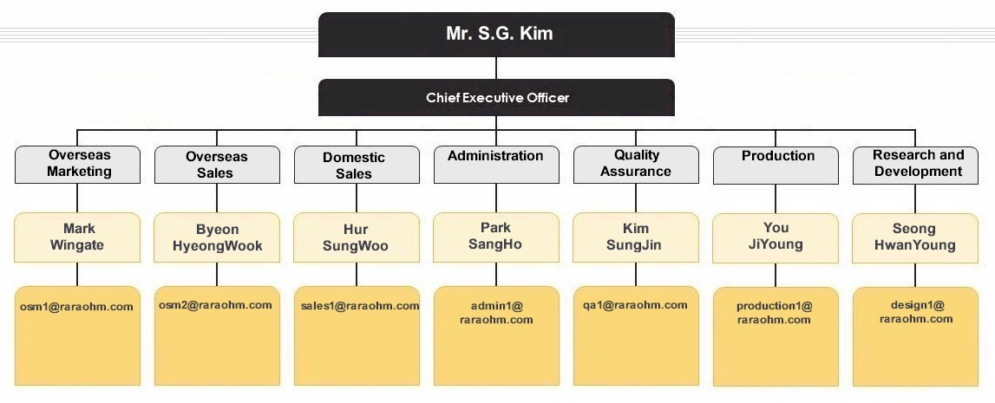
CORPORATE STRUCTURE

Slide 5
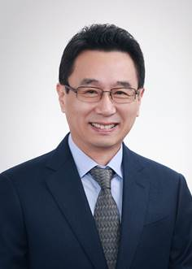
CEO’S MESSAGE
RARA Electronics, on the occasion of its 34th anniversary, expresses its gratitude to the collaborative efforts of the management, employees, and worldwide distributors, which have contributed to its continuous development as a resistor manufacturer. With an extensive network of distributors, RARA Electronics actively exports its products to Japan, the United States, Brazil, and Europe, maintaining relationships with 80 overseas customers across approximately 40 countries.
The key driver behind RARA Electronics' rapid growth in the highly competitive global market is its unique business strategy. The company established the first resistor research institute in Korea, enabling swift and cost-effective development of customer-specific products to cater to competitive markets. In line with its corporate philosophy of resolving all resistor-related issues, RARA Electronics has formed partnerships with firms in the United States, Germany, Japan, Taiwan, and China.
As a comprehensive provider, RARA Electronics offers a "ONE-STOP SOLUTION" service for industrial and special resistors, further enhancing its value proposition.
Sincerely, SG Kim,
CEO
January 3rd, 2023

Slide 6
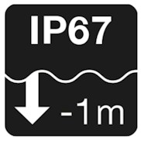
STANDARDS AND QUALITY ASSURANCES
2003 UL508
ULN/ULF
1998
ISO9001 Certification
2009 SPR
Korea Testing Labs
2002 UL508
ULV/H 60-500
2013
IATF16949
2003 ULH/ULV
TUV Rheinland
2015 AEC200
ECS/TCS

Slide 7
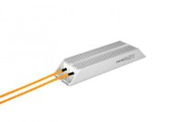
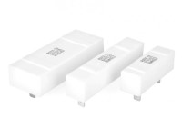
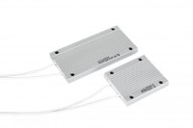
APPLICATION: Pre-charge
Model: ARH, ARV 60-500W
Model: AQL 20-60W
Model: IRN/ULN
50-500W

Slide 8
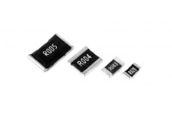
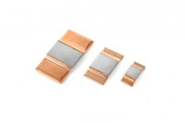
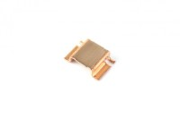
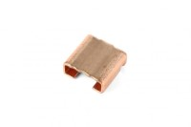
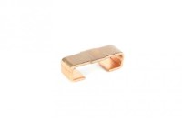
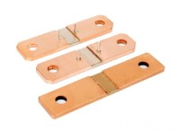
APPLICATION: Automotive
Model: LRA 0.5-5W
Model: ECS 1-15W
Model: BWR
4-5W
Model: BWB
2-12W
Model: BWN 2-5W
Model: TCS 12-36W
Model: AQL 20-60W
Model: IRN,ULN,IRF,ULF 50-500W
Model: ARH, ARV 60-500W

Slide 9
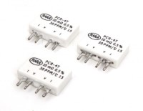
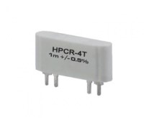
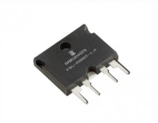
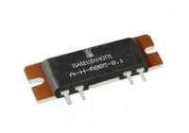
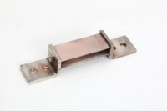
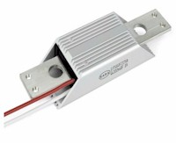
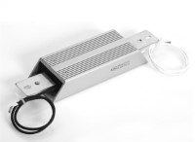
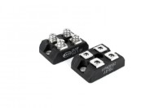
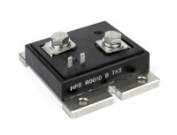
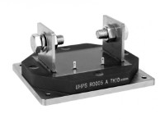
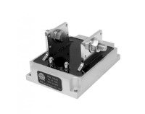
APPLICATION: Battery Testers
Model: LR 0.5-5W
Model: PCR4T 3W
Model: HPCR4T
35-65A
Model: PBV/PBH
3W, 10W
Model: AH 3W, 10W
Model: LT 50A-500A
Model: LPS 200A-300A
Model: IRHF 30A-500A
Model: CS227 25W
Model: HPS 250W
Model: UHPS 100W
Model: PSS 100W

Slide 10
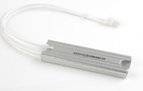
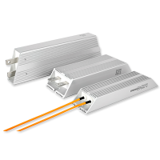
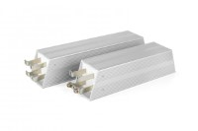
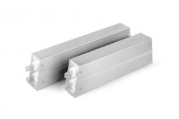
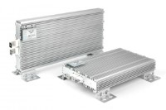
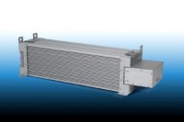
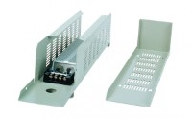
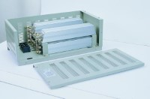
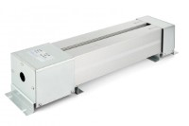
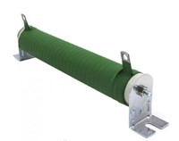
APPLICATION: Braking (1/2)
Model: IRHC 40-100W
Model: IRH/V,ULH,V 1-15W
Model: I/URN,I/ULF
4-5W
Model: IRV,ULV,IRM, ULM60-1200
600-1200W
Model: IRM/ULM 570-750W
Model: MBH/MBV 1KW-4.2KW
Model: MBVA 3.3KW-8.5KW
Model: RA 80W-750W
Model: HRA 520-2500W
Model: LCA 1KW-4.2KW
Model: K 15W-2KW
Model: EWS 400W-1600W

Slide 11
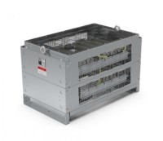
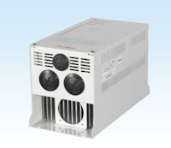
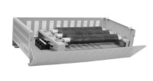
APPLICATION: Braking (2/2)
Model: EW 3-12KW
Model: DBR 8-60KW
Model: DBU
11-75KW

Slide 12
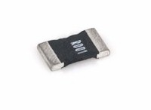
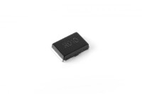
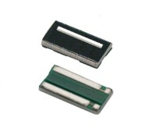
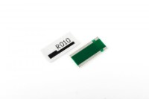
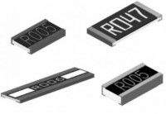
APPLICATION: SMD (1/3)
Model: LR 0.5-5W
Model: LRA 0.5-5W
Model: LR2512H
2-3W
Model: LRE
1/6-1W
Model: ECS 1-15W
Model: BWR 4W, 5W
Model: BWB 2-12W
Model: BWN 2-5W
Model: MR 2W, 3W, 5W
Model: MFF 0.33-4W
Model: MFR 0.33-5W
Model: CS 1/20-3W

Slide 13
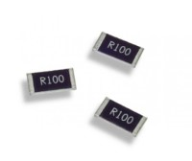
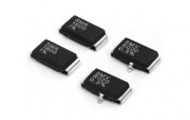
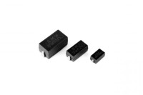
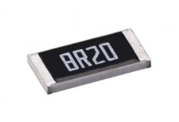
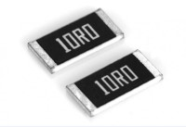
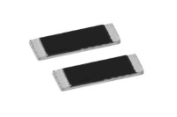
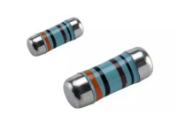
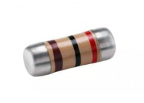
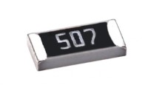
APPLICATION: SMD (2/3)
Model: CSTN 1/16-3W
Model: RS 1/16-2W
Model: RTX
1/8-2W
Model: SMV
5W
Model: SMW 2W, 3W, 5W
Model: AR 1/32-1W
Model: T 1/4-2W
Model: SM 1/8-2W
Model: CSR 1/4-2W
Model: CFS 1/4-2W
Model: SMF 2W, 3W, 5W
Model: HVTK (HVR) 1/16-1W

Slide 14
APPLICATION: SMD (3/3)
Model: SMG 1W, 2W, 3W
Model: TNP25, TNP45 25W, 45W

Slide 15
APPLICATION: Loadbanks
Model: RLB 50KW-3000KW

Slide 16
FACTORY TOUR
16

Slide 17
BUILDING AND HEAD OFFICE
Originally 924 m², in 1995,
this site has grown to its
current floor space of
2489 m².

Slide 18
ADMINISTRATION
As with any other factory,
there is sales, marketing
accounting and purchasing.

Slide 19
EDUCATION CENTER
Production techniques,
safety, orientation and
numerous other subjects
are taught here.

Slide 20
MEETING ROOM
In house meetings are
conducted here as well
as conferences with
buyers etc.

Slide 21
ELEMENT PRODUCTION
Manufacturing resistors
entails several steps. One
of which is measuring,
cutting and placement of
the resistive element.

Slide 22
ASSEMBLY AND MOLDING
The assembled elements
must be housed. This is
typically done with:
-aluminum casing
-cement
-epoxy

Slide 23
MOLDING ROOM
This room can get dusty
and contaminated. The
particulates are filtered
and then vented to the
outside.

Slide 24
QUALITY ASSURANCE AND PACKAGING
All products are tested for
correct ohmic value and
for tolerance before
packaging. Moreover a
visual inspection for any
other manufacturing faults
is carried out.

Slide 25
EXPORT SALES DATA

Slide 26
DOMESTIC SALES DATA

Slide 27
SALES BY REGION

Slide 28
SALES BY PRODUCT

Slide 29
LOCATION AND CONTACT INFORMATION
RARA Electronics LLC (100BL-11L) 666-19 Kojan-dong,
Namdong-gu, Incheon, South Korea
405 310 Tel: 82-32-817-4325
Fax: 82-32-817-4328
Our office

Slide 30
Keys to business success
Quality products
Customer Service
Success

